Slide 1

Creating system engineering products with executable models in a model-based engineering environment
An Executable MBSE Method (ESEM) to
Support Requirements Analysis and Verification
June 25, 2016, Robert Karban
Jet Propulsion Laboratory,
California Institute of Technology
Notes:
25+5 minutes presentation
An Executable MBSE Method (ESEM) to Support Requirements Analysis and Verification

Slide 2
Outline
Current State of Practice and Need for MBSE
System Development Process
TMT Application
Infrastructure for Integrated (System) Modeling
Summary

Slide 3
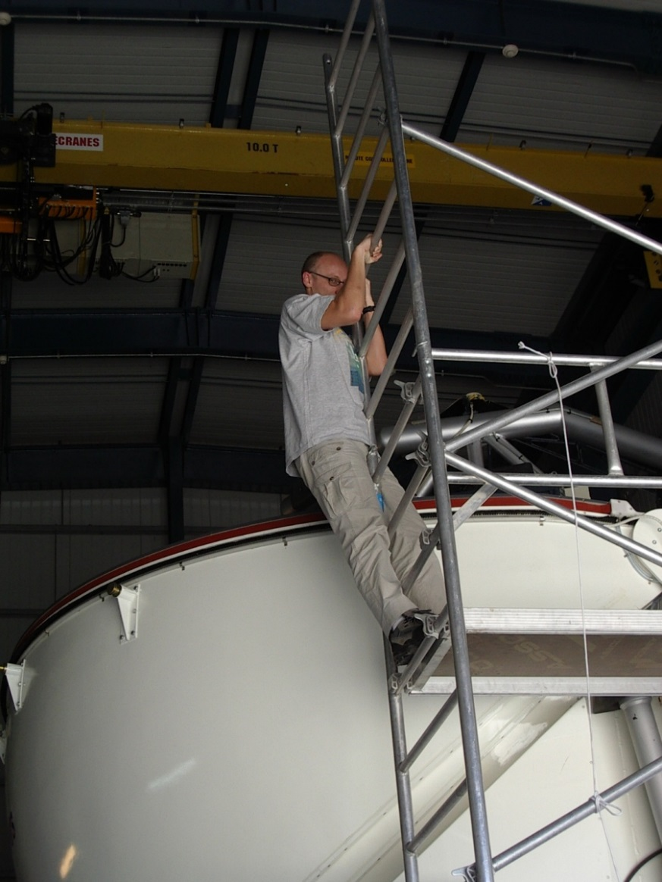
Who is Robert?
Senior Systems Architect and Systems Engineer at NASA’s JPL - USA
CAE, IMCE, TMT, Europa
Member of INCOSE
Member of the OMG SysML Revision Task Force
Formerly Control System/Software Engineer and Architect at:
European Southern Observatory – Germany, Chile
CERN – Switzerland/France
Siemens Healthcare - Austria
M.Sc. Computer Science (Austria)

Slide 4
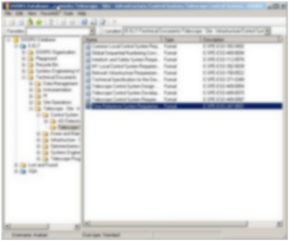
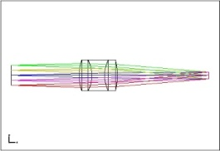
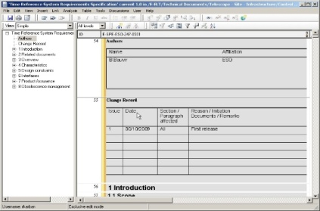
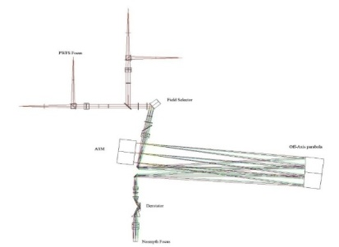
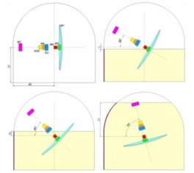
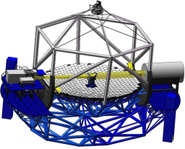
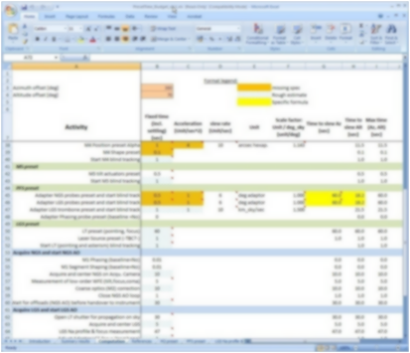
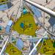
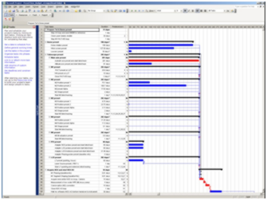
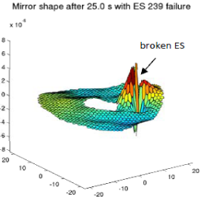
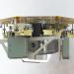
Current State of Practice and Need for MBSE
Current State or Practice
Modeling is ubiquitous in domain specific engineering (CAD, FEA, MATLAB)
Many other document based artifacts
The Need for MBSE
Tie in system level models into existing modeling
Provide method and tooling environment to do it

Slide 5






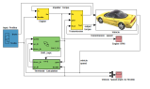
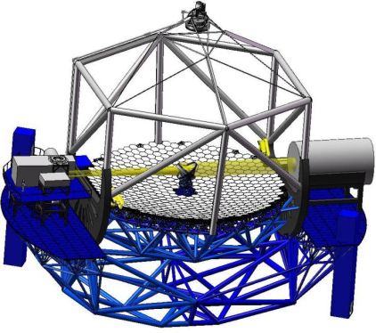
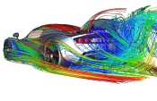





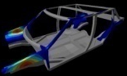
Systems Engineering Inadequacies of A Traditional Document-Based Approach
Finance
Software
Analysis
Implicit Dependencies between Documents
Project Management
Power plant
Structure
Control
Mirrors
…
Manufacturing
CAD
Notes:
Many stakeholder, all with their own view of the vehicle / Enterprise
But they are all views of the SAME system → the views depend on each other
Currently, dependencies are often implicitly represented, hidden in documents
Emphasize RISK!!! And consistency…
(S)Es are busy to find out what other SEs or Engineers do...
Many people still think they are able to keep all under control using documents and their brain ☺

Slide 6
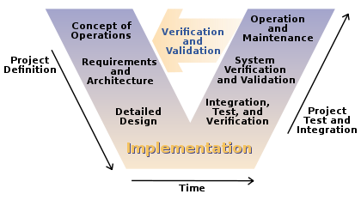
INCOSE V-Model

Slide 7
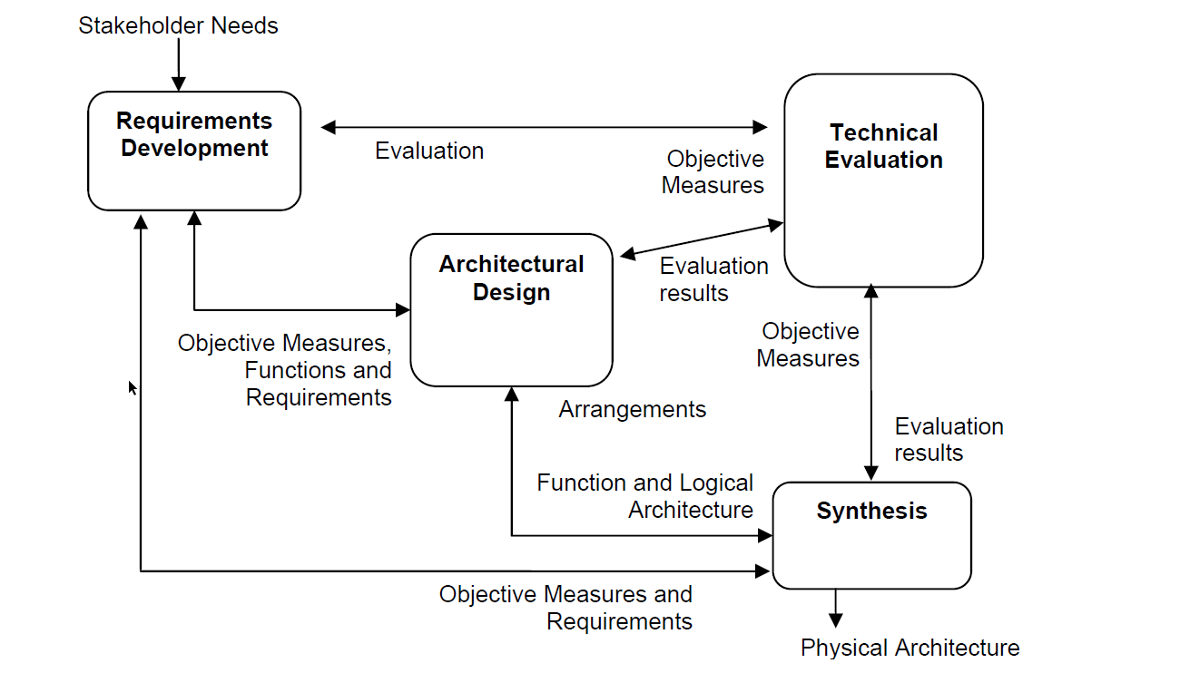
Typical Systems Engineering Process
Credit: Pearce P., Hause M., “ISO-15288, OOSEM and Model-Based Submarine Design”, SETE, APCOSE 2012

Slide 8
Model Based Systems Engineering
MBSE is the formalized application of modeling techniques to support system requirements, design, analysis, verification, validation and documentation activities
MBSE expresses a system using a Systems Modeling Language (SysML), a profile of UML
MBSE is often applied with a method like Object Oriented System Engineering Method (OOSEM)
OOSEM maps onto the ISO systems engineering process and integrates top-down (functional decomposition) approach with model-based approach

Slide 9
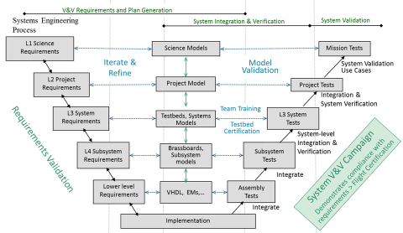
Model-based V-Process at JPL

Slide 10

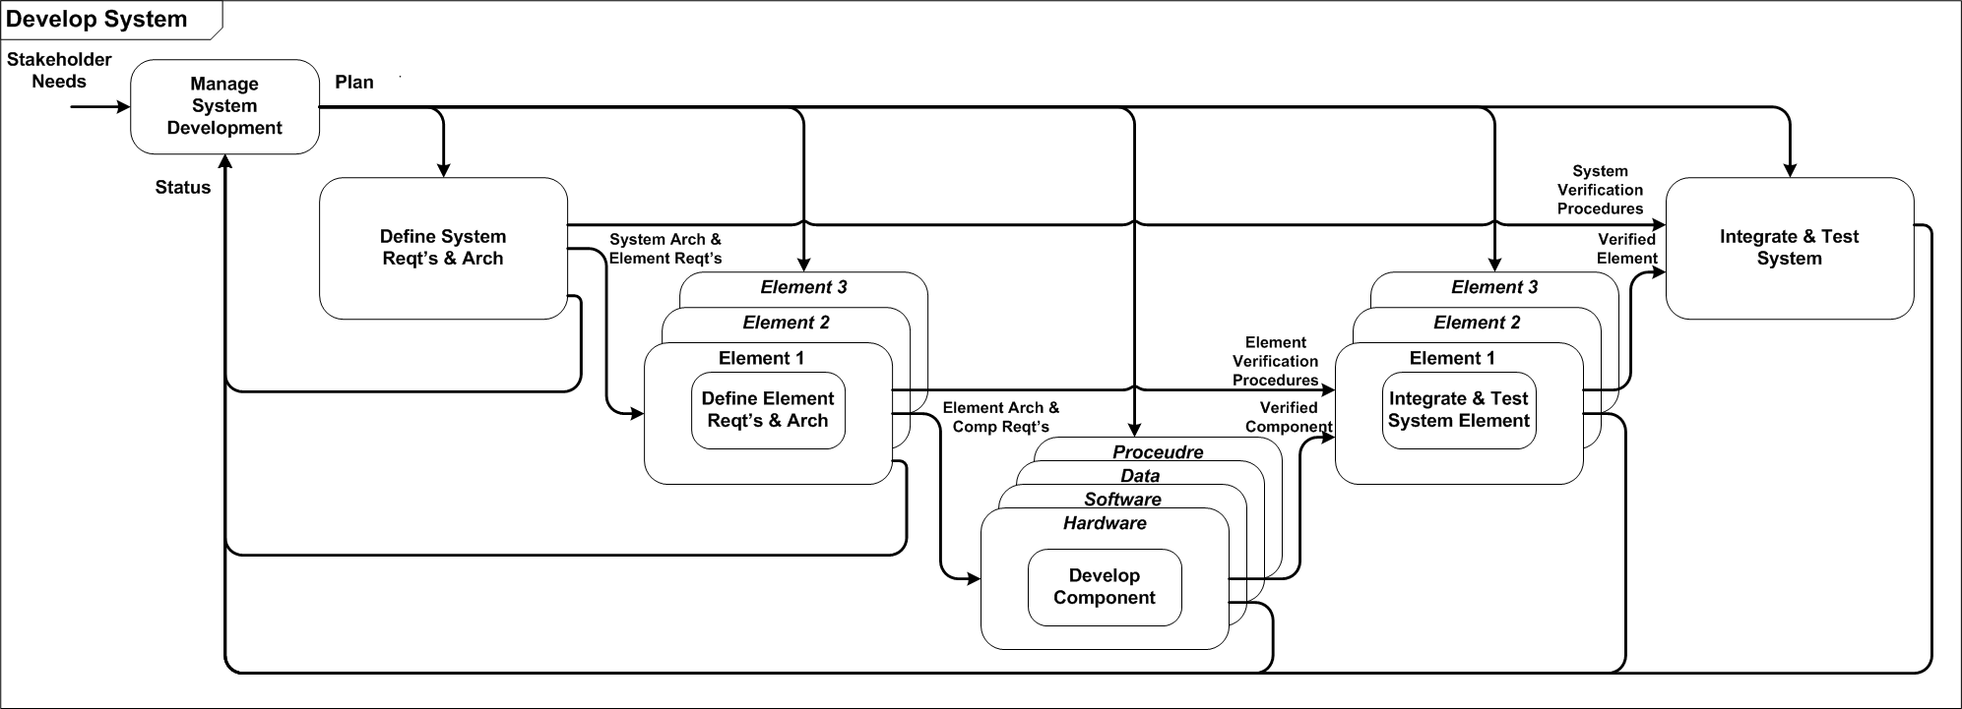
System Development Process
Iteration N
Iteration 1
OOSEM
Activities
Integrated Product Development (IPD) is essential to improve communications
Applied iteratively throughout the system life cycle
A recursive V - process
Credit: Friedenthal S, Moore A., and Steiner R., [A Practical Guide to SysML 3rd Ed.] Morgan Kaufmann OMG Press, 2014

Slide 11
Executing OOSEM Systems Requirements & Design Models with ESEM
Analyze Stakeholder
Needs
Causal analysis
Mission use cases
Domain model
Major SE Development Activities
Leverage executable project and system models - ESEM
Analyze
System
Requirements
System context
System scenarios
Define Logical Architecture
Logical decomposition
Logical scenarios
Logical interconnection
Optimize &
Evaluate Alternatives
Critical parameters
Trade studies & analysis
Synthesize Physical Architecture
System nodes
HW/SW/Data architecture
Physical interconnection
Component specs
Manage
Requirements
Traceability
Reqt’s
Trace
Support
Validation & Verification
Test cases
Test procedures
Common Subactivities
Credit: Friedenthal S, Moore A., and Steiner R., [A Practical Guide to SysML 3rd Ed.] Morgan Kaufmann OMG Press, 2014

Slide 12
Systems Analysis
Carry out quantitative assessments of systems in order to select and/or update the most efficient system architecture and to generate derived engineering data.
System analysis provides a rigorous approach to technical decision-making. It is used to perform trade-off studies, and includes modeling and simulation, cost analysis, technical risks analysis, and effectiveness analysis.

Slide 13
Requirements Verification
A kind of systems analysis that assesses whether a system design meets the objectives and satisfies the constraints that are implied by the system requirements

Slide 14
Executable Models
Most SysML models today are created for documentation purposes
The focus is on syntax and notation
Some SysML models are created to gain system understanding, explore and validate desirable or undesirable behaviors of a system
The focus is on semantics

Slide 15
Proposed Approach
Next phase of system modeling emphasizes executable models to enhance understanding , precision, and verification of requirements
Executable Systems Engineering Method (ESEM) augments the OOSEM activities by enabling executable models
ESEM produces executable SysML models that verify requirements
Includes a set of analysis patterns that are specified with various SysML structural, behavioral and parametric diagrams
Also enables integration of supplier/customer models

Slide 16
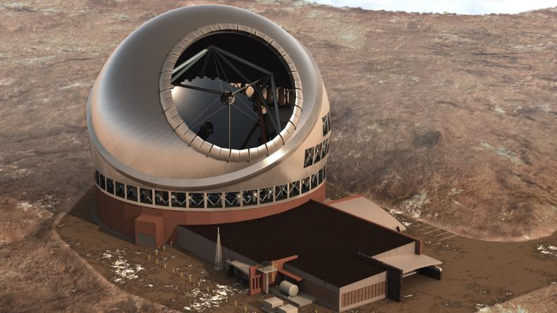
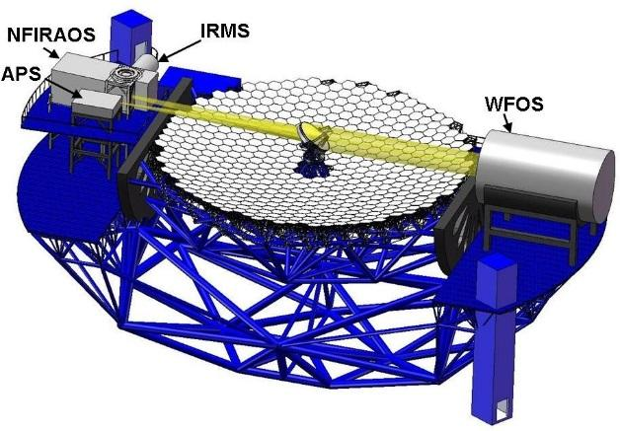
Thirty Meter Telescope (TMT) www.tmt.org
Developed by TMT International Observatory (TIO)
JPL participates in several subsystems of TMT
APS (and AO) team uses MBSE to analyze requirements, produce design, and perform analysis
Alignment and Phasing System (APS)
Sensor responsible for measuring the pre-adaptive optics wavefront quality

Slide 17
TMT MBSE Objectives
Use MBSE to define executable SysML model that captures requirements, operational scenarios (use cases), system decomposition, relationships and between subsystems, etc.
Use the model to analyze the system design for
power consumption, mass, and duration
Produce engineering documents
Requirement Flow Down Document
Operational Scenario Document
Design Description Document
Interface Control Documents
Uses standard languages and techniques where practical to avoid custom software development

Slide 18
Typical Analysis Activities Using ESEM
Capture operational use cases with estimated durations of actions, e.g.
Post segment-exchange alignment: requirement: 2h; CBE 1h19m
Capture power and mass characteristics of components
Identify involved subsystems, e.g. Telescope Control System (TCS), M1 Control System (M1CS)
Identify interfaces and interactions among subsystems
Analyze associated scenarios
Automatically verify system requirements are met
Derive requirements for TMT subsystems
Develop/refine timing requirements for algorithms, internal and external interface commands
Notes:
Capture relevant information in a SysML model (system database) using ESEM (Executable Systems Engineering Method)
Used SysML constructs
Block diagrams, State Machines, Activity Diagrams, Sequence diagrams
Simulate system level scenarios
Verify correctness by
Recording traces of simulation in sequence diagrams
Ensure all “leaf” actions have durations constraints applied
Ensure that all actions have been reached in the different scenarios
Automatically verify timing against formal constraints (requirements)
Follow ESEM to define two white box specifications that specialize the black box specification
Conceptual Specification
Realizations Specification
Decompose the white box specifications into elements representing the subsystems

Slide 19
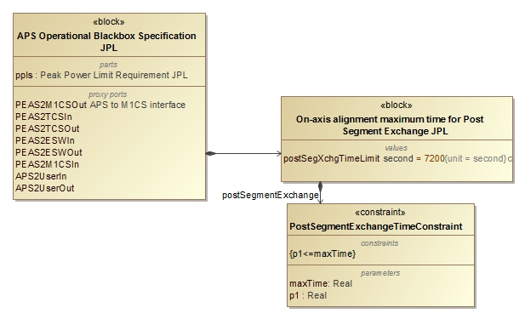
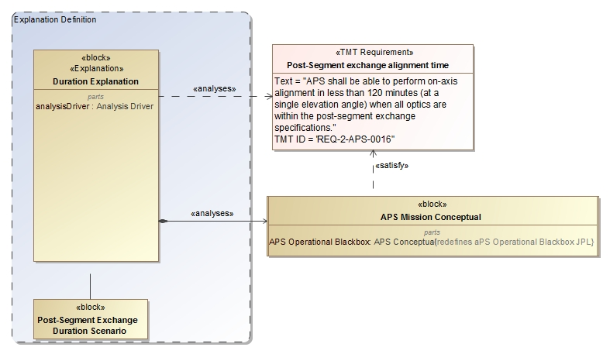
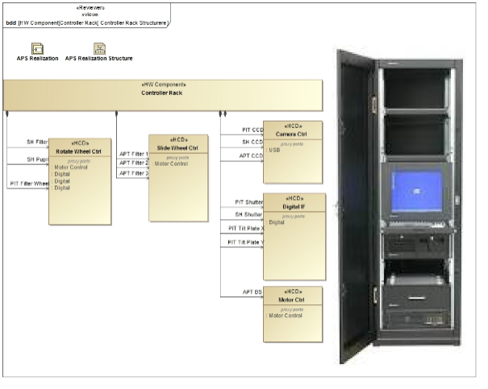
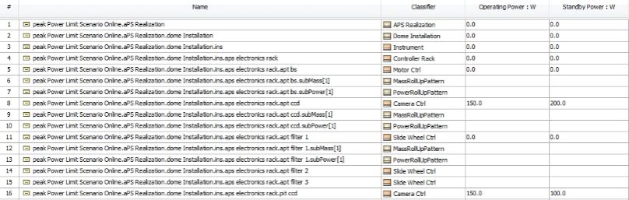
Analysis of Architecture and Design
Update Requirements
Analyze Conceptual Design
2
4
3
Analyze Realization Design/Specification
5
1
Max duration Post-segment exchange: 7200s 5000s
Number of exposures of 45s 4 6
Max peak power consumption in dome: 8.5kw 8.1kw Number of motors with 50W 10 12
6
Pass/fail
OCD, Requirements, ICD, DDD
Notes:
Touches on all modeling capabilities: construction, visualization, analysis, management, exchange and integration, collaboration and workflow

Slide 20
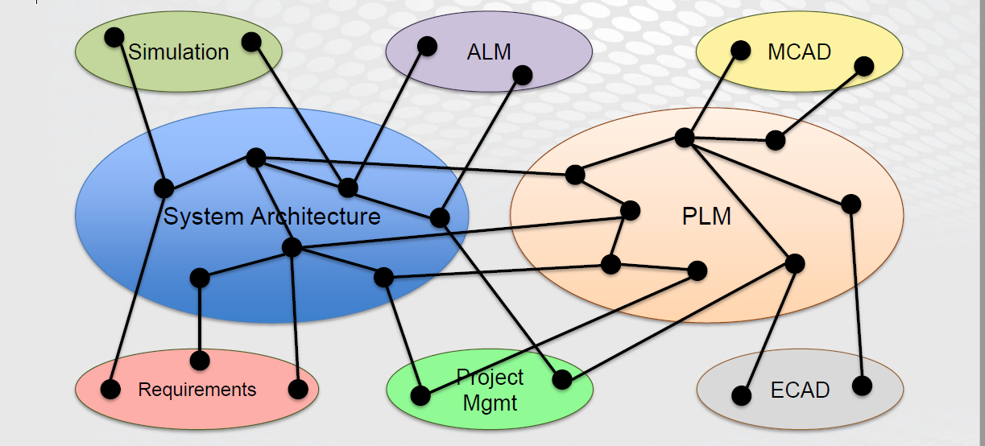
Integrating ESEM with other Models
Credit: Zwemer, D., “Connecting SysML with PLM/ALM, CAD, Simulation, Requirements, and Project Management Tools”, Intercax LLC, May 201
Notes:
Goal of MBE is to create a single unified model extending over all the tools and data repositories
Diverse multi-vendor engineering toolset.
Create and store product/system data in a variety of tools, models, and repositories: PLM, ALM, CAD, spreadsheets, databases, SysML models
Captured in a graph where the nodes of the graph can be structural elements, behaviors, requirements and the edges can be constraints, dependencies
Become standard practice

Slide 21
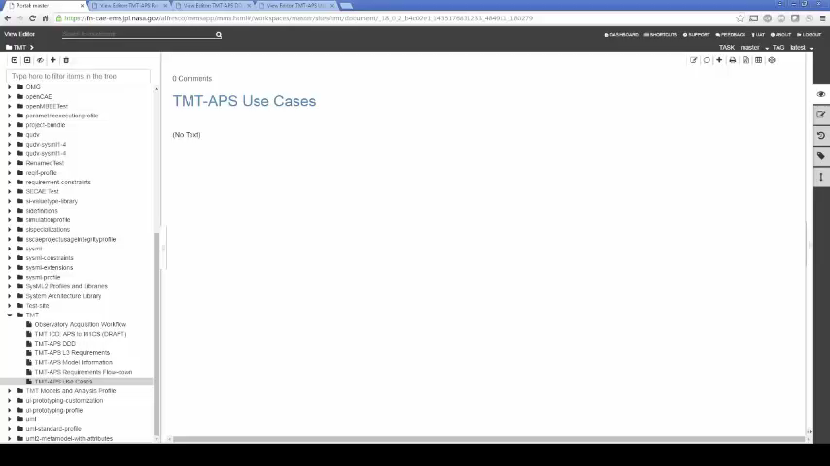
System Level Analysis

Slide 22
OpenMBEE https://github.com/Open-MBEE
Provides a platform for modeling that integrates JPL’s mission environment OpenCAE, by incorporating a model repository that can be accessed for example with a rich SysML desktop client (MagicDraw) and a light-weight web-based client (ViewEditor)
The model repository provides the following features:
Basic Infrastructure for Version, Workflow, Access Control
Flexibility of content
Support for Web Applications and Web-based API access
Multi-tool and multi-repository integration across engineering and management disciplines

Slide 23
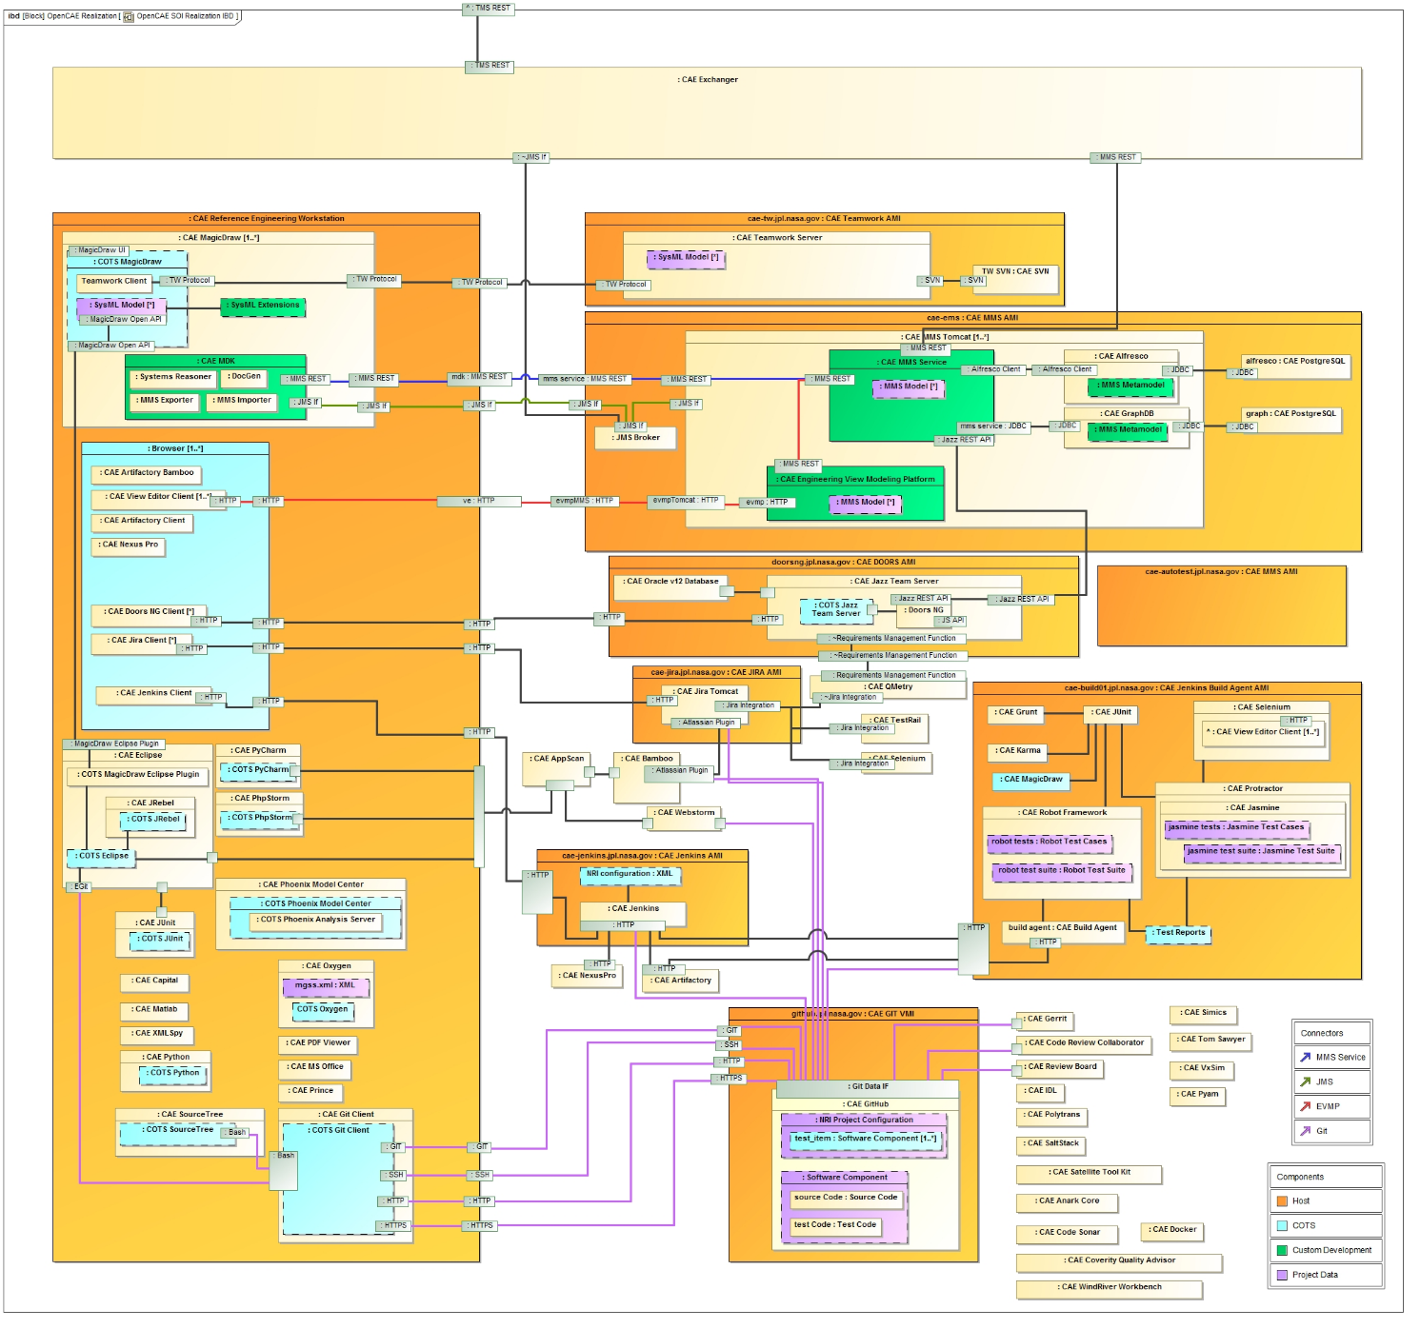
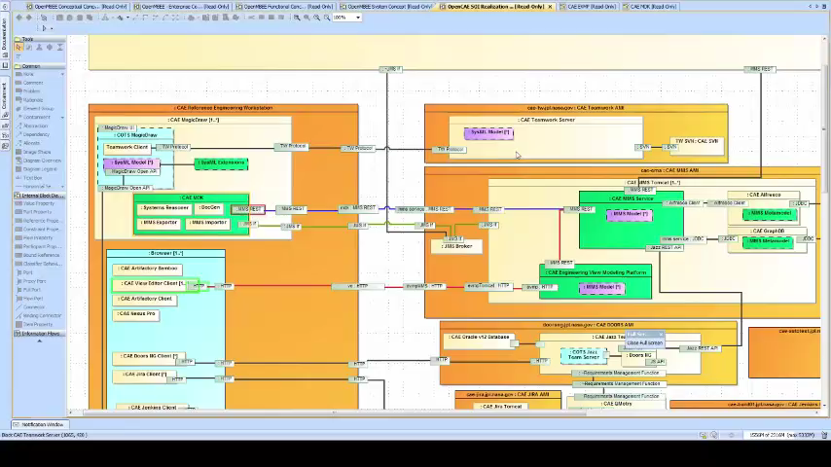
OpenMBEE Current Realization

Slide 24
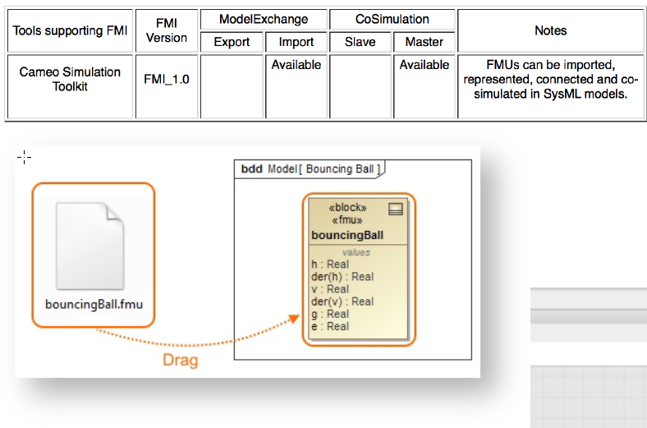
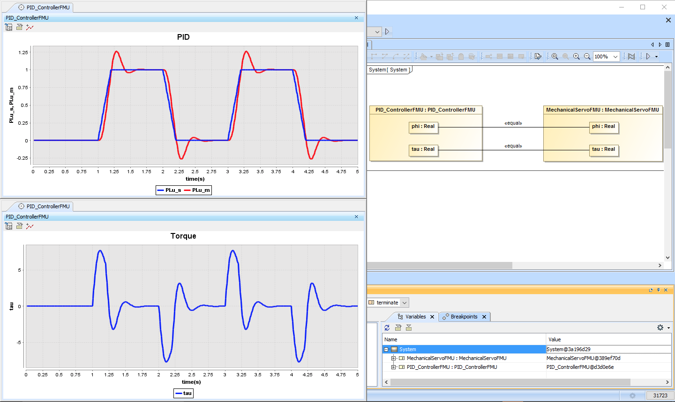
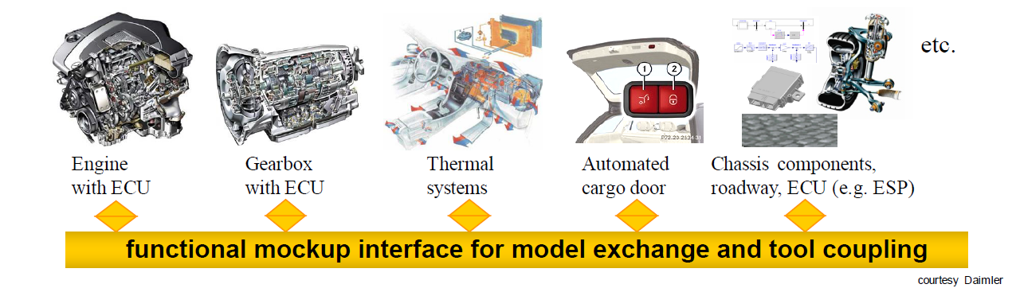
Outlook: Standardized Co-simulation
The Functional Mock-up Interface (or FMI) defines a standardized interface to be used in computer simulations to develop complex cyber-physical systems.
Integration with System Level behavior model

Slide 25
Summary
Models are ubiquitous in domain engineering
Still many disconnected document based artifacts
Integration of requirements and behavioral/performance model
Method and infrastructure exist to tie in system level models into domain specific models
Leverage model executability (OOSEM + ESEM) and Co-simulation (FMI) and Co-Analysis
Automated requirements verification of architecture and design
Consistent Model Based Project Documentation

Slide 26
Acknowledgments
The research was carried out at the Jet Propulsion Laboratory, California Institute of Technology, under a contract with the National Aeronautics and Space Administration and NoMagic.
The TMT Project gratefully acknowledges the support of the TMT collaborating institutions. They are the Association of Canadian Universities for Research in Astronomy (ACURA), the California Institute of Technology, the University of California, the National Astronomical Observatory of Japan, the National Astronomical Observatories of China and their consortium partners, and the Department of Science and Technology of India and their supported institutes. This work was supported as well by the Gordon and Betty Moore Foundation, the Canada Foundation for Innovation, the Ontario Ministry of Research and Innovation, the National Research Council of Canada, the Natural Sciences and Engineering Research Council of Canada, the British Columbia Knowledge Development Fund, the Association of Universities for Research in Astronomy (AURA) and the U.S. National Science Foundation.

Slide 27
Reference
Karban, R., Jankevičius, N., Elaasar, M. “ESEM: Automated Systems Analysis using Executable SysML Modeling Patterns”, (to appear in the proceedings of INCOSE International Symposium (IS), Edinburgh, Scotland, 2016.)
Karban, R., “Using Executable SysML Models to Generate Systems Engineering Products”, NoMagic World Symposium, Allen, TX, 2016
Open Source TMT model: https://github.com/Open-MBEE/TMT-SysML-Model
Open Source Engineering Environment: https://github.com/Open-MBEE
A Practical Guide to SysML, 3rd Edition, Chapter 17 by Friedenthal, Moore, and Steiner
Zwemer, D., “Connecting SysML with PLM/ALM, CAD, Simulation, Requirements, and Project Management Tools”, May 2016

Slide 28
Backup

Slide 29
Executable System Engineering Method (ESEM)
Step 1: Formalize Requirements
Step 2: Specify Design
Step 3: Characterize Components
Step 4: Specify Analysis Context
Step 5: Specify Operational Scenarios
Step 6: Specify Analysis Configurations
Step 7: Run Analysis

Slide 30
Step 1: Formalize Requirements
Requirement Pattern
Customer Side
Define the textual requirement with a Requirement
Optionally define a design black box specification with a Block with relevant value properties
Optionally refine the Requirement with a Constraint Block on the black box design Block
Supplier Side
Define a design black box specification with a Block (that refines the customer’s black box Block if any and provides tighter property values)
Refine the textual Requirement by a Constraint Block (if not already defined by the customer)

Slide 31
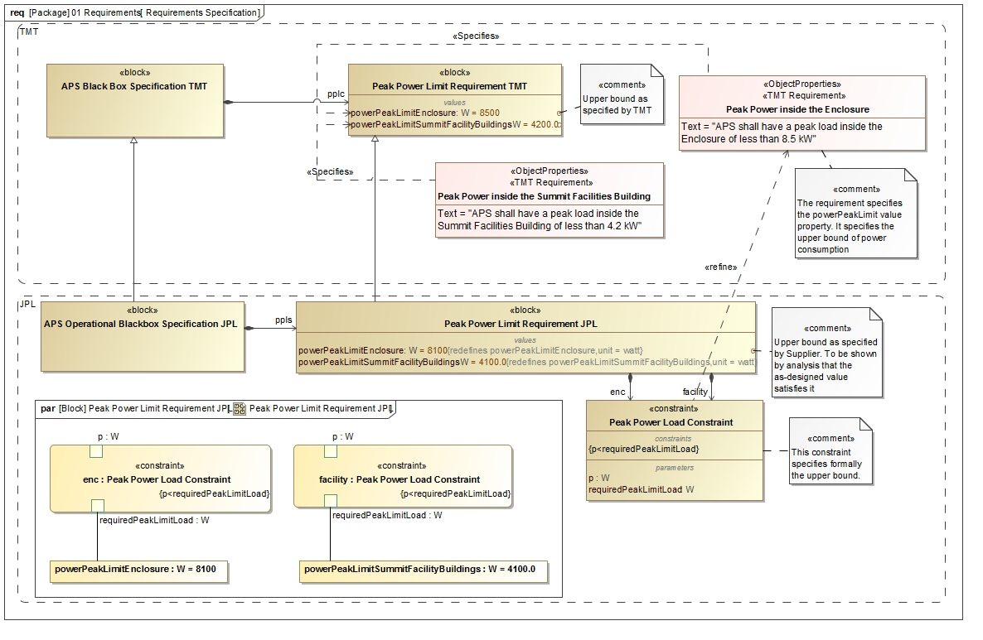
Step 1: Formalize Requirements

Slide 32
Step 2: Specify Design
Follow OOSEM to define two white box specifications that specialize the black box specification
Conceptual Specficiation
Realization Specification
Decompose the white box designs into Blocks representing the subsystems

Slide 33
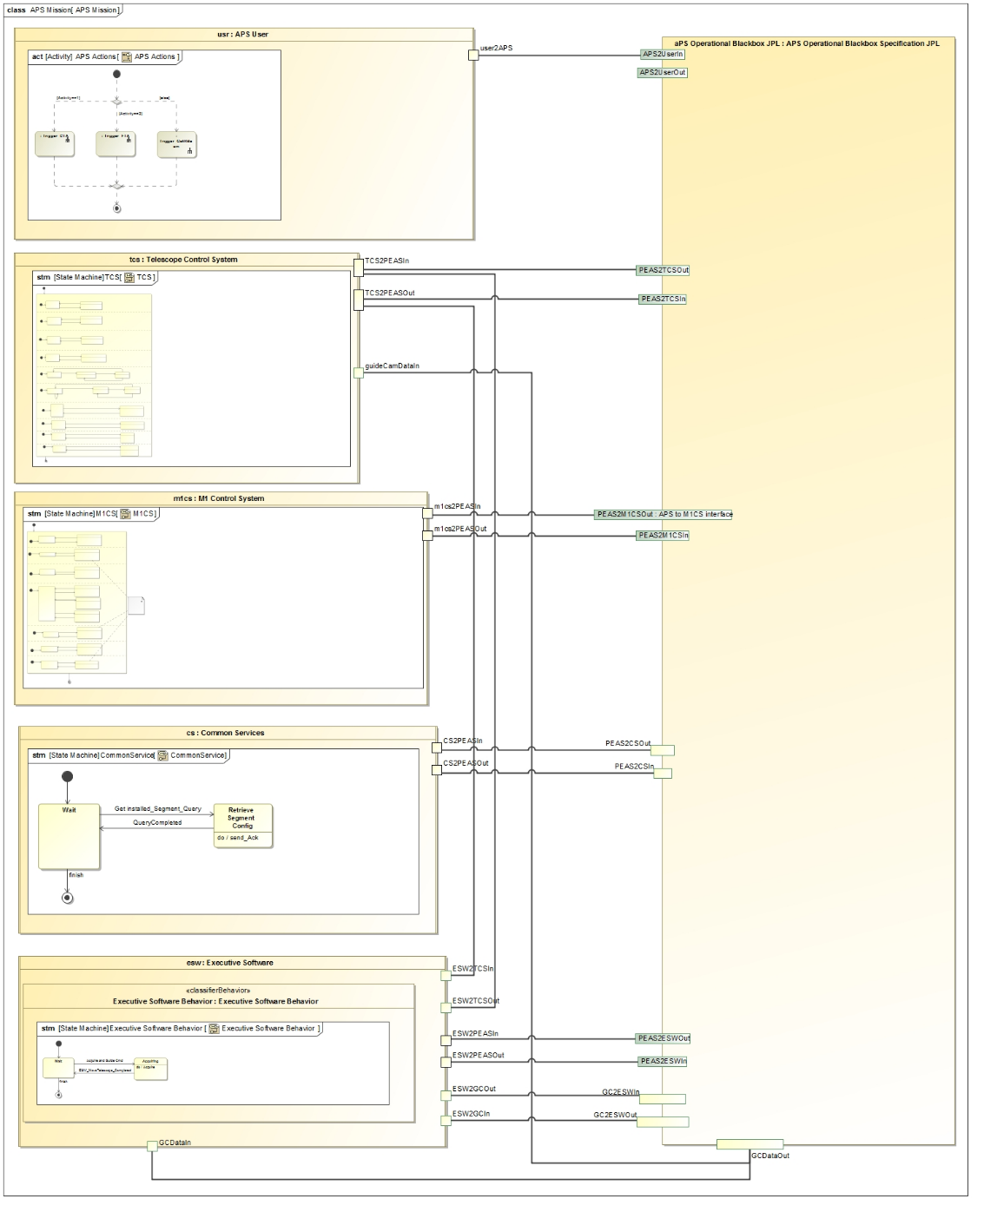
Black Box Level
Operator
Project level components communicate with APS black box block
TCS
APS Black Box
M1CS
CS
ESW

Slide 34
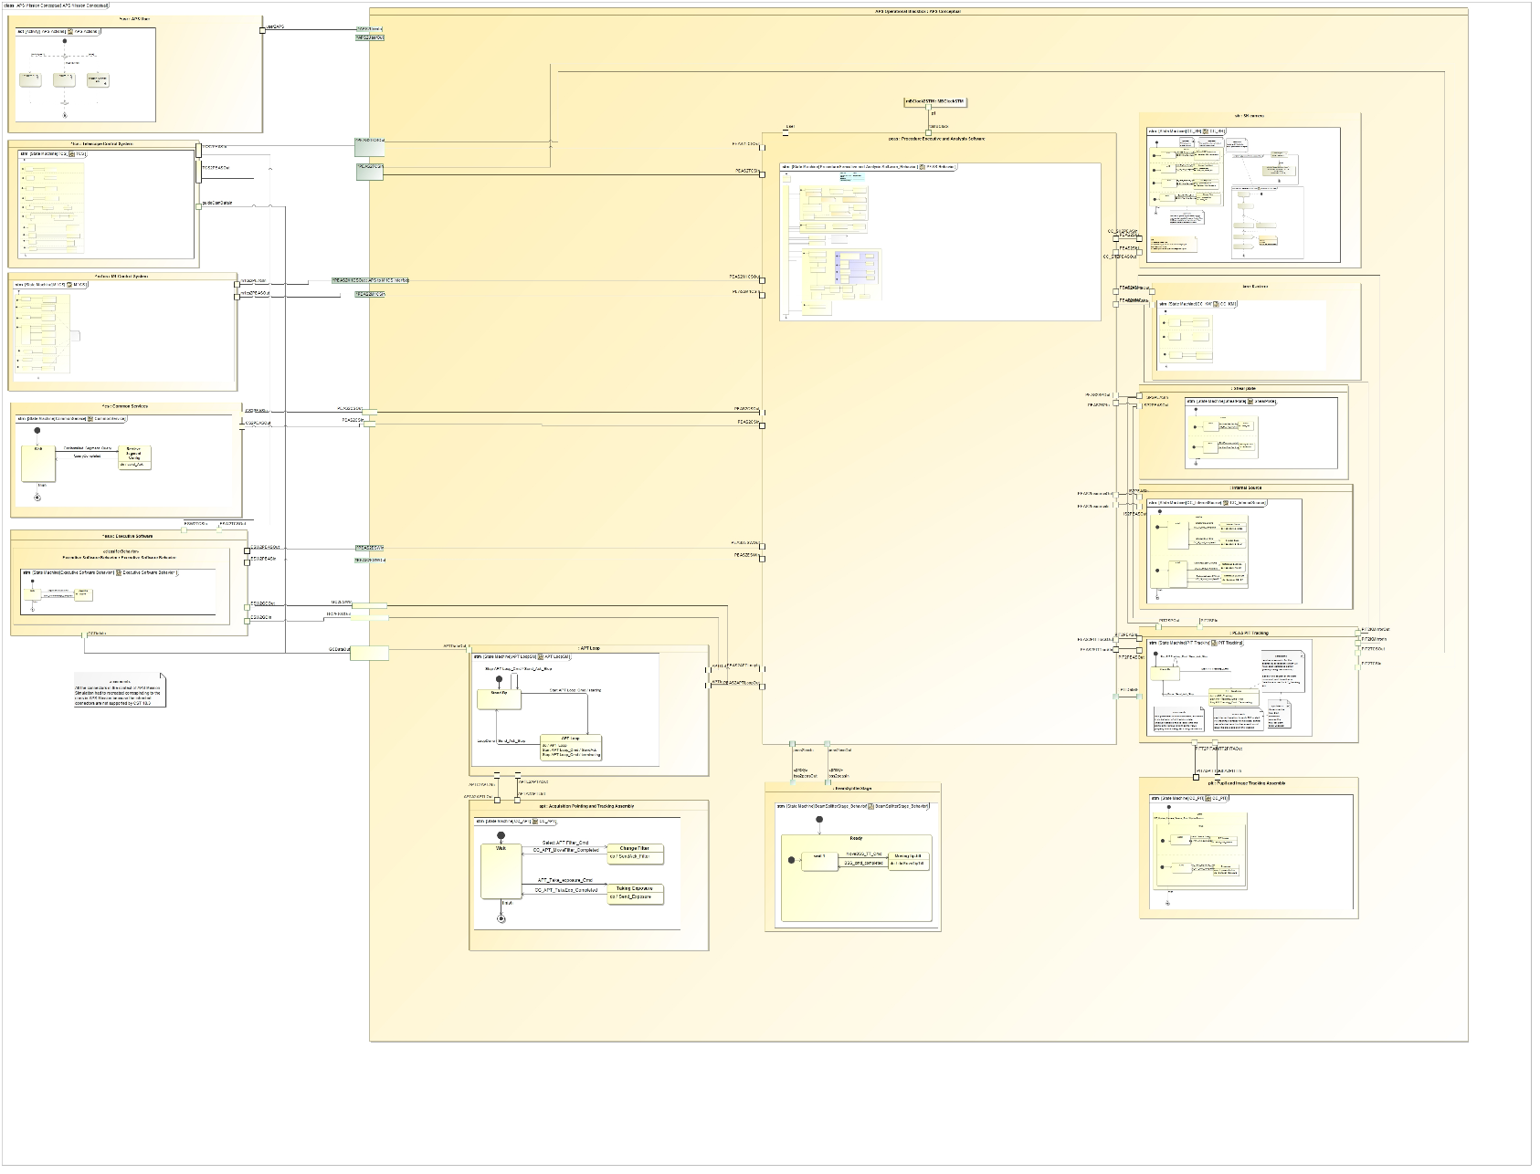
Step 2: Conceptual Model
SH
PEAS
M1CS
Communication between state machine specified components over ports

Slide 35
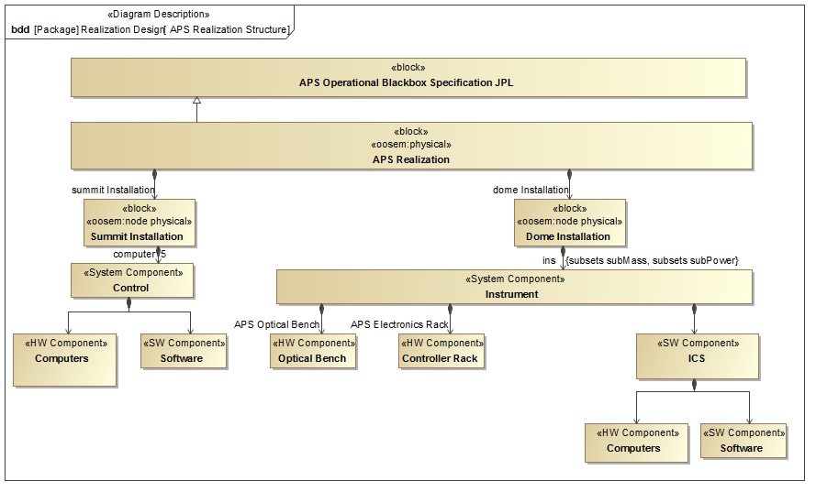
Step 2: Realization
System Decomposition Hierarchy

Slide 36

Step 2: Realization
System Decomposition Hierarchy

Slide 37
Step 3: Characterize Components
Add relevant patterns to the design Block to make it executable
Example: Roll-up Pattern
Constrained value represents an aggregate value that is propagating up a hierarchy of subcomponents
Static roll-up (e.g., mass roll-up)
Dynamic roll-up (e.g., power roll-up)

Slide 38
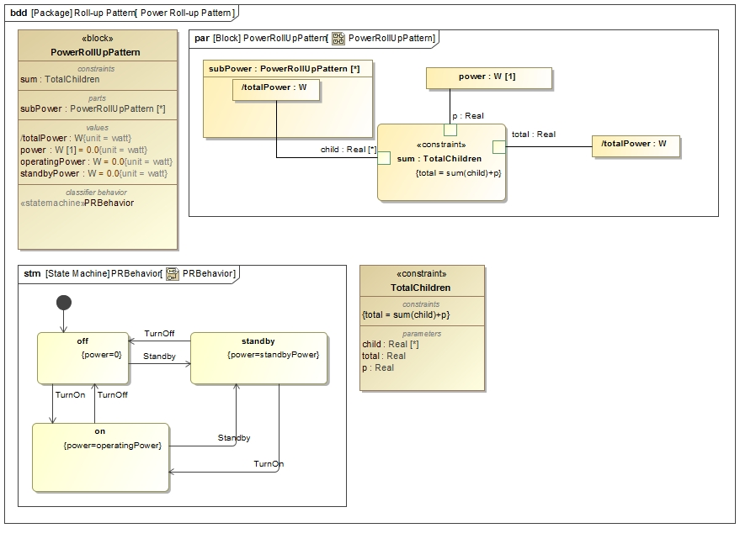
Step 3: Characterize Components
State constraints
Power Rollup Pattern

Slide 39
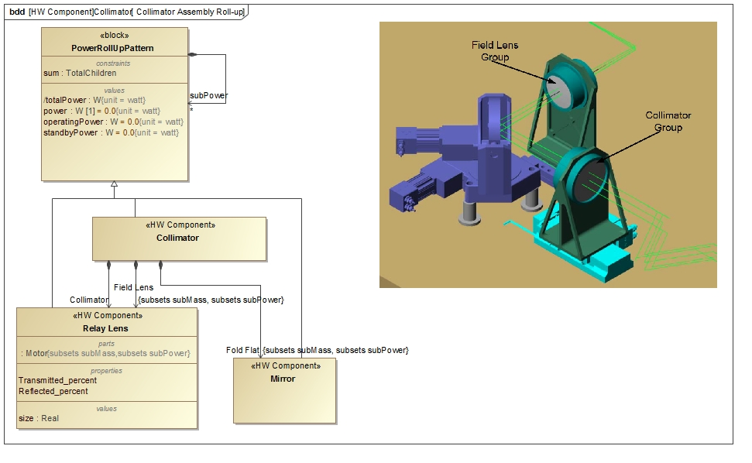
Step 3: Characterize Components
Power Roll-up Pattern Application

Slide 40
Step 4: Specify Analysis Context
Analysis Context Pattern
Abstract analysis context Block composes both the design black box Block and white box Block
Analysis properties defined on the analysis context Block (e.g., peak power, power margin)
Analysis parametric model on the analysis context that computes and binds analysis values

Slide 41
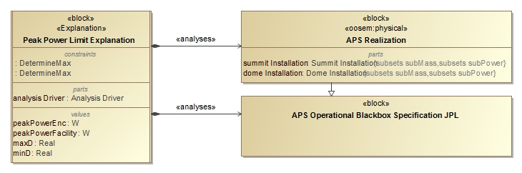
Step 4: Specify Analysis Context
Analysis Context Pattern

Slide 42
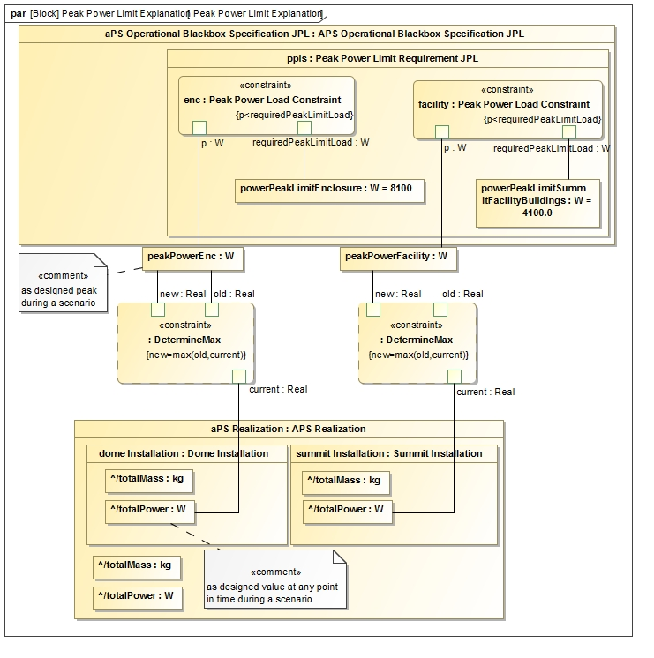
Step 4: Specify Analysis Context
Analysis Context Parametric Model

Slide 43
Step 5: Specify Operational Scenarios
Operational Scenario Pattern
Concrete analysis context Block that
Represents one operational scenario (e.g., power configuration)
Specializes the abstract analysis context Block
Redefines context’s properties with scenario-specific values
Defines an owned behavior (sequence diagram) as scenario driver
Changes the states of the different components, by sending them signals, causing the rolling-up to occur automatically
Can specify duration constraints to time the injection of signals thus controlling time spent in a certain state
Can use state constraints (on components) to verify during execution if a component is actually in expected state

Slide 44
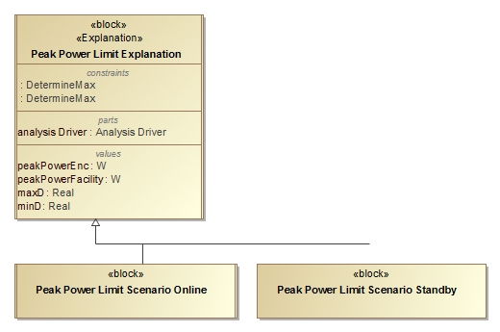
Step 5: Specify Operational Scenarios
Operational Scenario Pattern

Slide 45
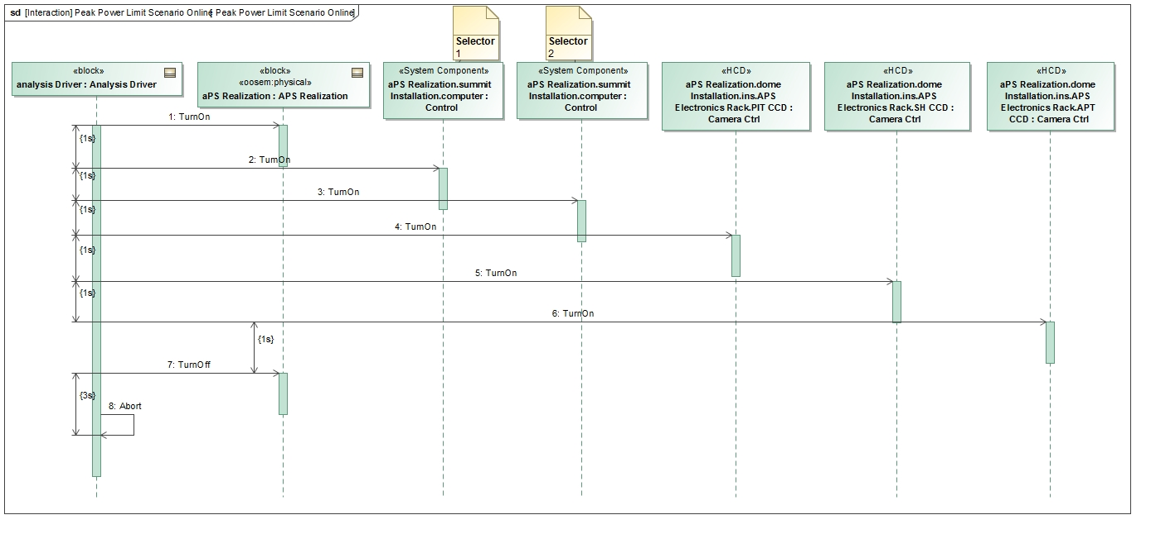
Step 5: Specify Operational Scenarios
Operational Scenario Driver

Slide 46
Step 6: Specify Scenario Configurations
Scenario Condition Pattern
A decomposition tree of instance specifications representing the state of the scenario
Can be presented in tabular form
Rows represent the instance specifications (e.g., component)
Columns represent values (e.g., operating power) from the instance specifications
Issues
Hard to keep instance specifications in sync with Block hierarchy
Mitigation: tool automation
Instance specifications cannot be displayed in IBDs
Mitigation: use full specialization tree of singleton Blocks for each scenario

Slide 47
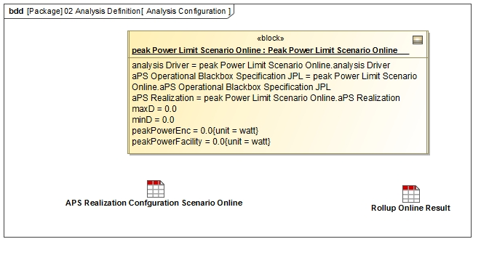
Step 6: Specify Analysis Configurations
Scenario Configuration Pattern

Slide 48
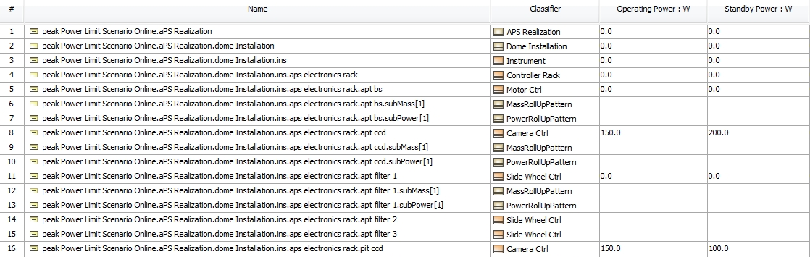
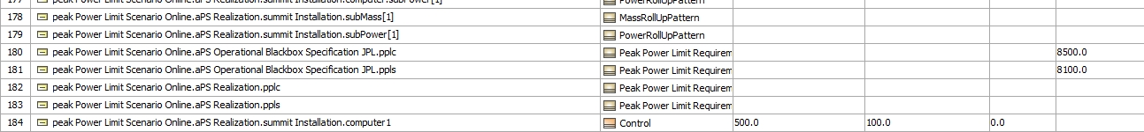
Step 6: Specify Analysis Configurations
Scenario Initial Condition Pattern

Slide 49
Step 6: Specify Scenario Configurations
Scenario Configuration Pattern
Scenario configuration is an Instance Specification of the scenario’s concrete analysis Block
References an initial scenario condition with an <<analyzes>> relationship
References a final scenario condition with an <<explains>> relationship

Slide 50
Step 7: Run Analysis
Run the configured analysis with a simulation engine on the initial conditions to get the final conditions:
Produce the following views on final conditions
Table showing final analysis values (e.g., peak power) and the constraint’s pass/fail status for each scenario
Timelines: state changes for components over time
Value profiles: total rolled up values over time

Slide 51
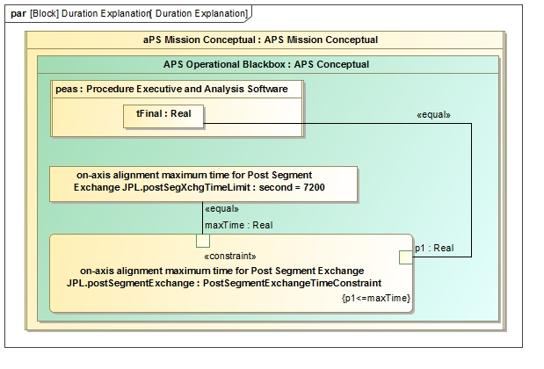
Duration Analysis
Specify Property Based Requirement
Analyze Conceptual Design

Slide 52
Step 2: Conceptual Model
Communication between state machine specified components over ports

Slide 53
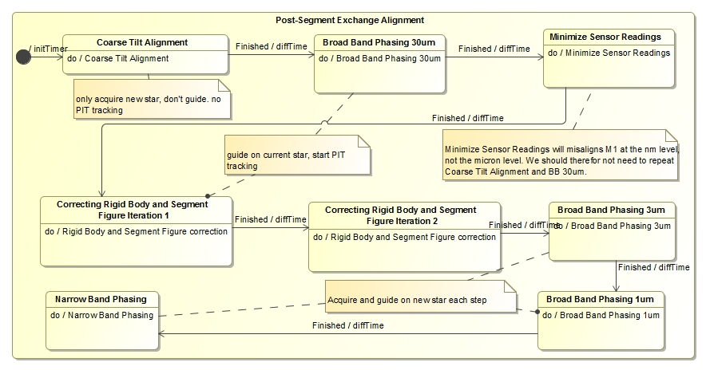
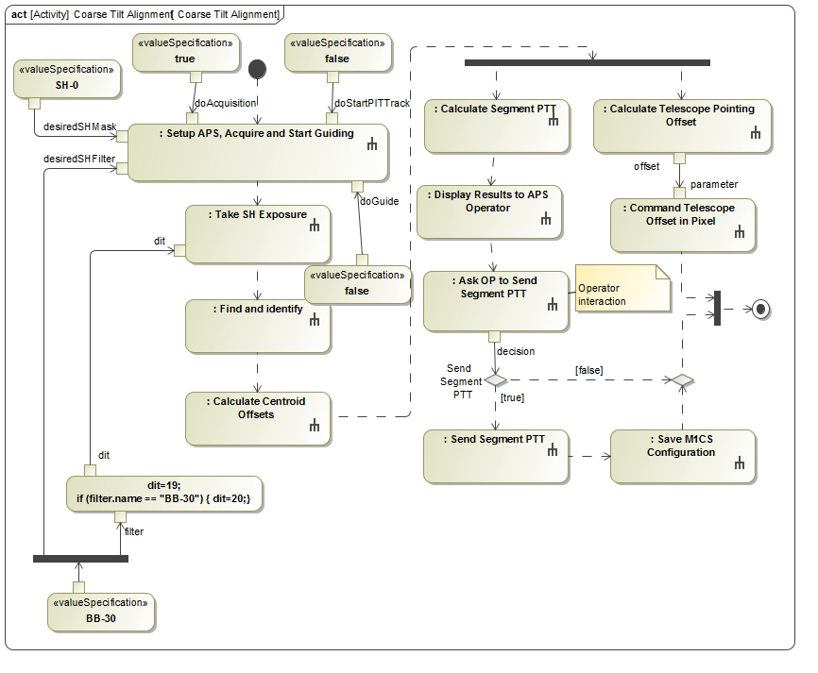
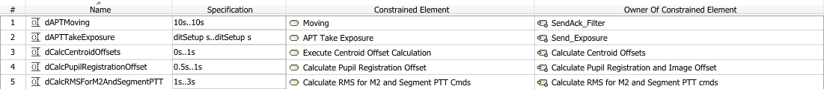
Conceptual Design
1
Operational behavior captured with
state machines and activity models
2

Slide 54



Conceptual behavior model
3
Dynamic and fixed duration constraints
1
Communicating
state machines
2
Duration analysis results verified against requirement for a particular configuration
4

Slide 55


OpenMBEE Core Integration
Model of Document in
MagicDraw/Model Development Kit
MMS repository
Rendered and editable document in Web interface View Editor

Slide 56

Interchanges between conceptual components
Provides information for ICD from conceptual behavioral model

